Slide 1

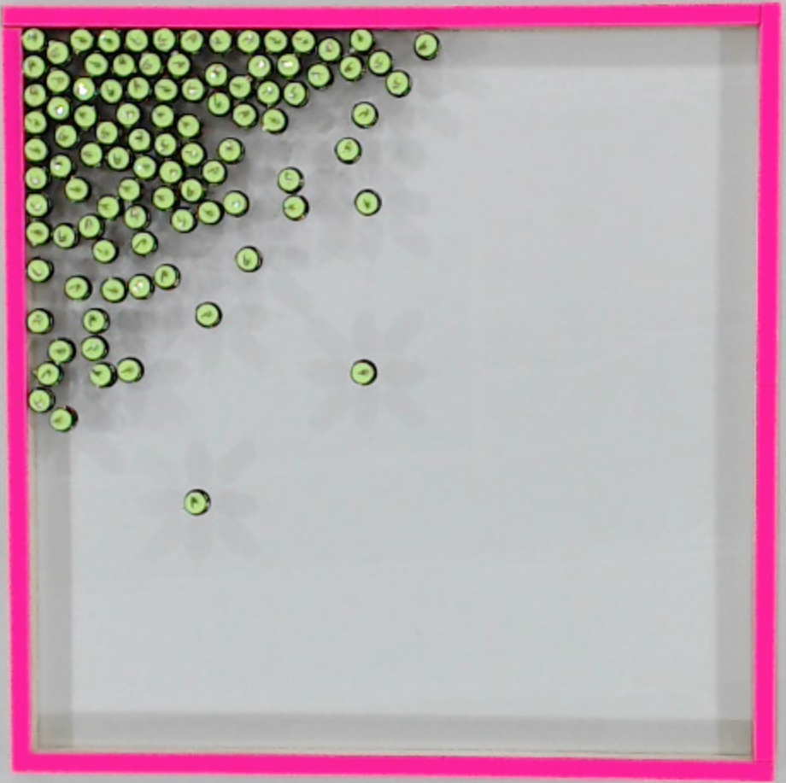
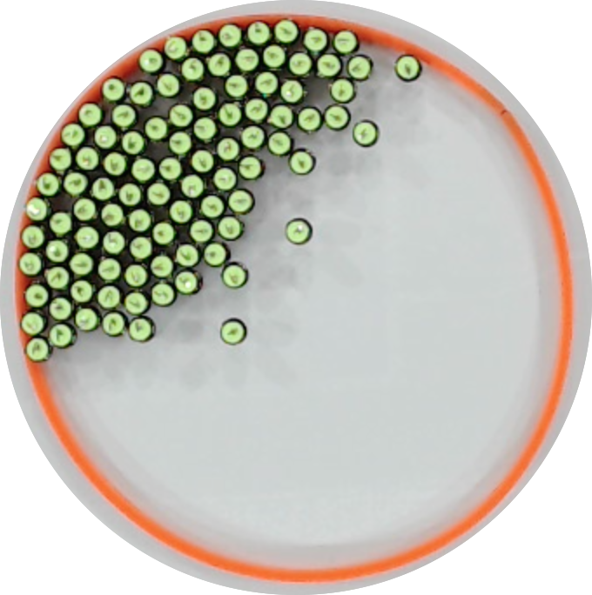
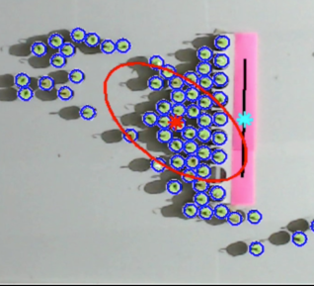
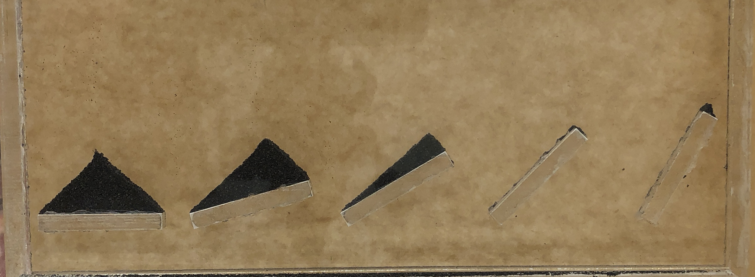
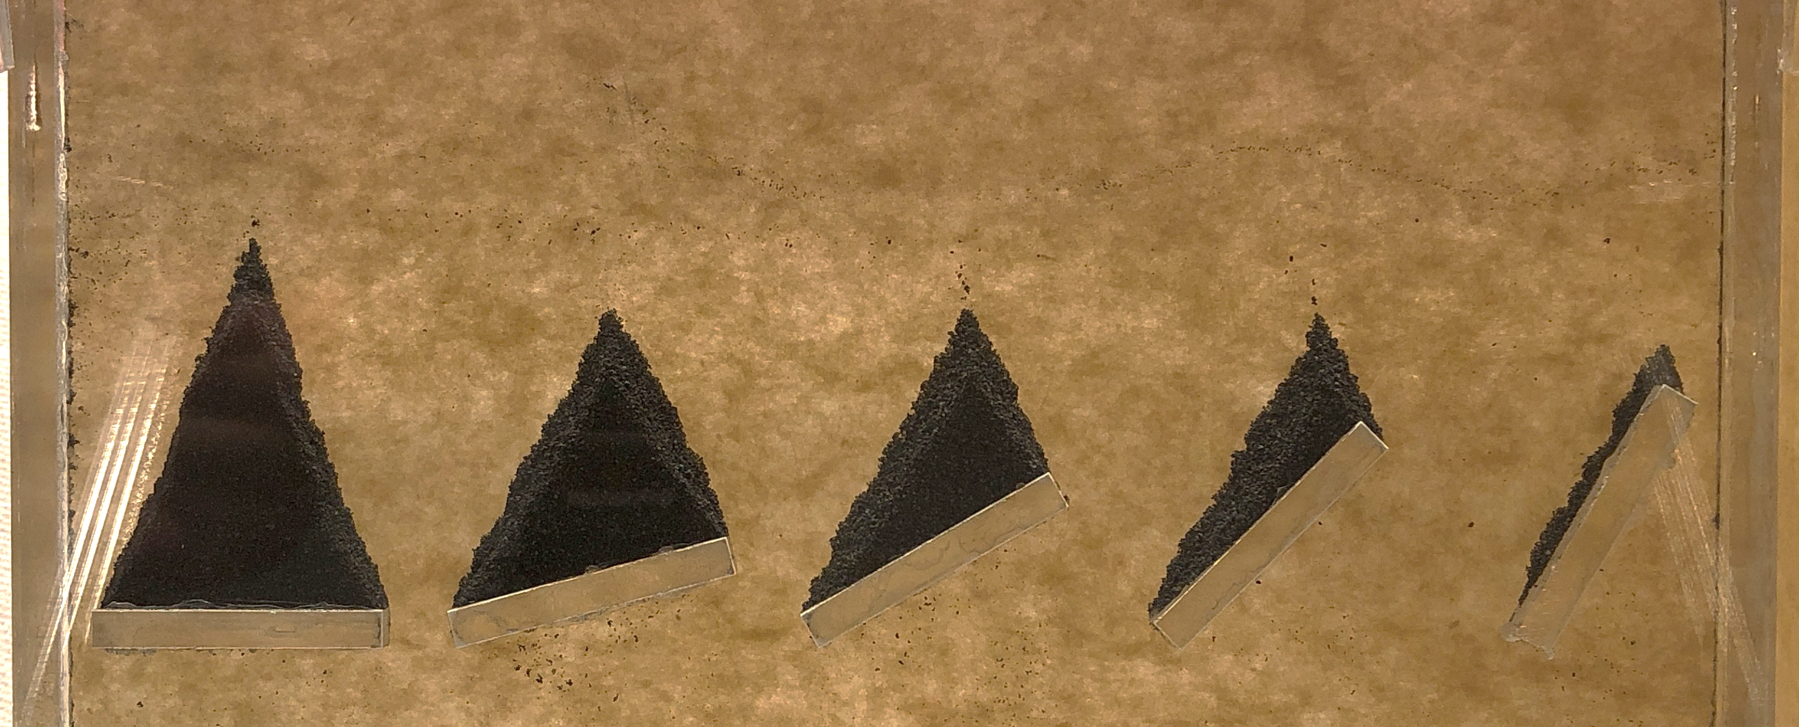
Light direction
Light direction
α ~ 50°
1.0 gravity force
varying angle of attack: 90° 75° 60° 45° 30°
Light direction
α ~ 63°
0.7 gravity force
angle of repose α ~ 43°

